Slide 1
Invariance Matters: Exemplar Memory for Domain Adaptive Person Re-identification
cvpr2019
胡超杰
2019.4.19

Slide 2
domain adaptive
labeled data
model
unlabeled
data

Slide 3
underlying invariance
exemplar-invariance
camera-invariance
neighborhood-invariance

Slide 4
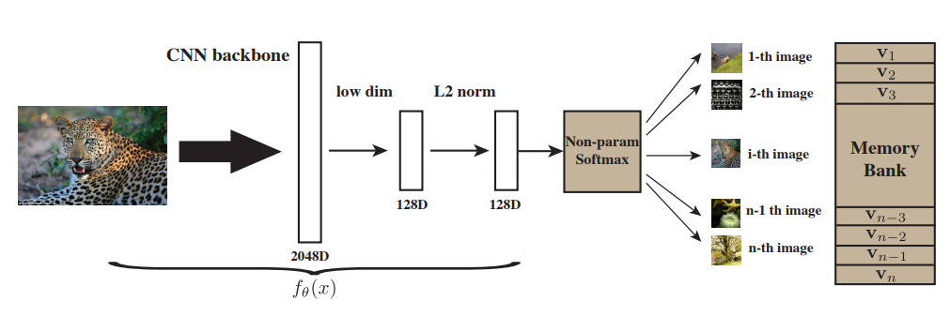


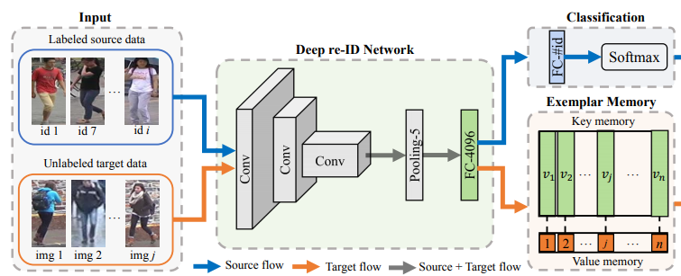
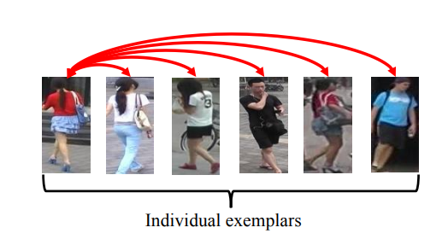
exemplar-invariance

Slide 5
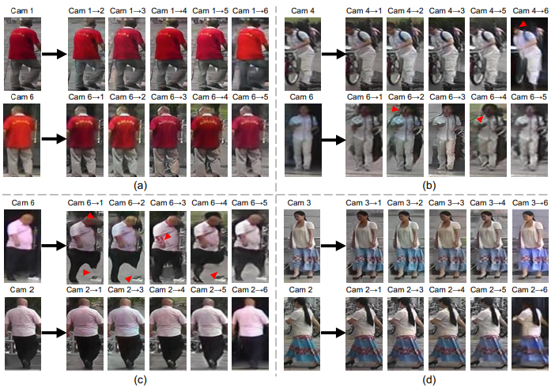
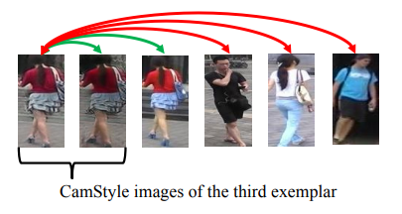
Camera-invariance

Slide 6

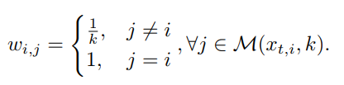

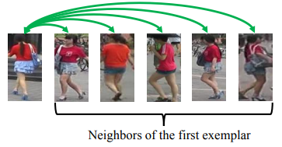
Neighborhood-invariance
k-nearest neighbors：

Slide 7
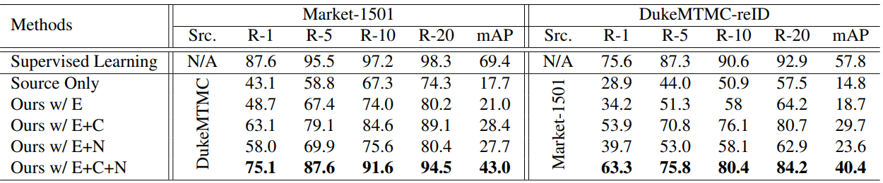
Experiment

Slide 8
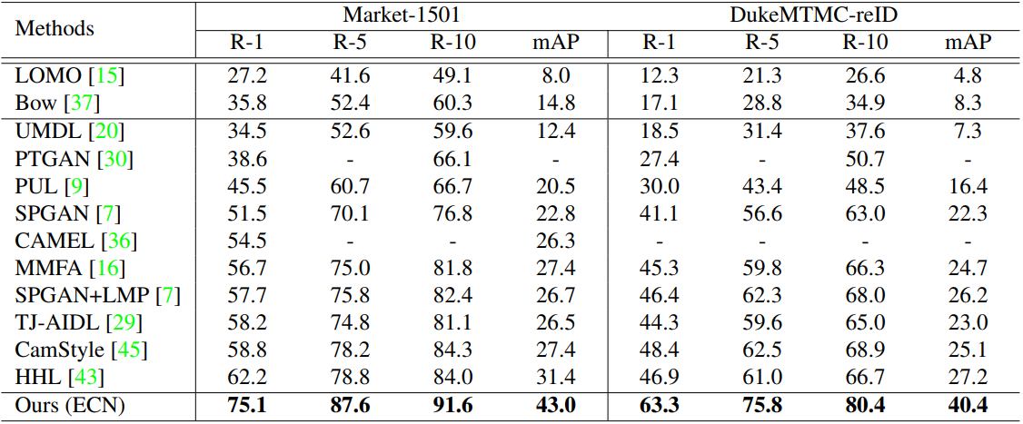
Experiment

Slide 9
Thanks！

